Slide 1
Sustainable Urbanism
“…walkable and transit-served urbanism integrated with high-performance buildings and high-performance infrastructure.”
Neighborhoods (40 to 200 acres)
Districts
Corridors
Farr 2008
Notes:
“…walkable and transit-served urbanism integrated with high-performance buildings and high-performance infrastructure.”
Neighborhoods (40 to 200 acres)
Compact, pedestrian-friendly, mixed-use
Districts
Single Use Areas– college campus, industrial park
Corridors
Connect Neighborhoods and districts
Boulevards, rail lines, rivers, parkways

Slide 2
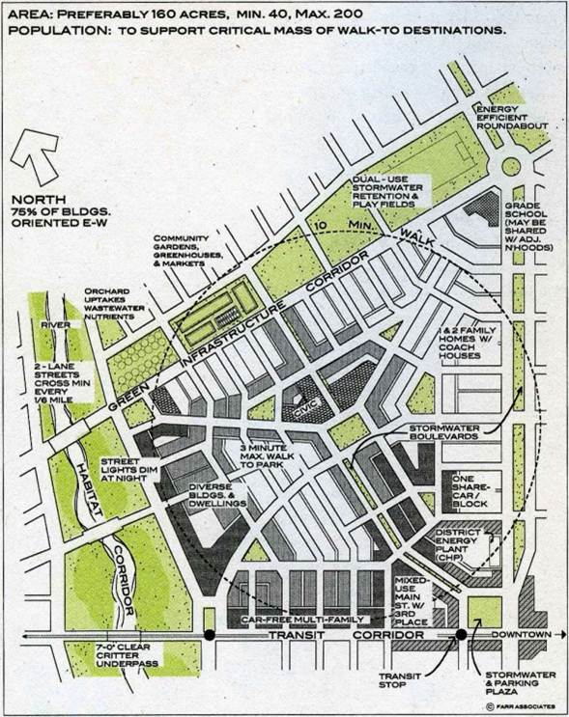
Neighborhoods
Farr 2008
bettercities.net
Notes:
Defined Center & Edge
Compactness
Completeness
Connectedness
Biophilia
High Performance Buildings & Infrastructure

Slide 3
Defined Center & Edge
Center – Market
Edge / Boundary
Sense of responsibility
Maintenance
Local stormwater management
Finite social network - Get recognized, meet friends on street
Farr 2008
Notes:
Intimate communities seldom have more than about 150 members. Dunbar's number is based on studies of social animals, which have shown a correlation between the typical frontal brain capacity the members of a species and the maximum size of the groups in which they live.^{[3]} The number of relationships the human brain can handle is large but not unlimited. - Wikipedia

Slide 4
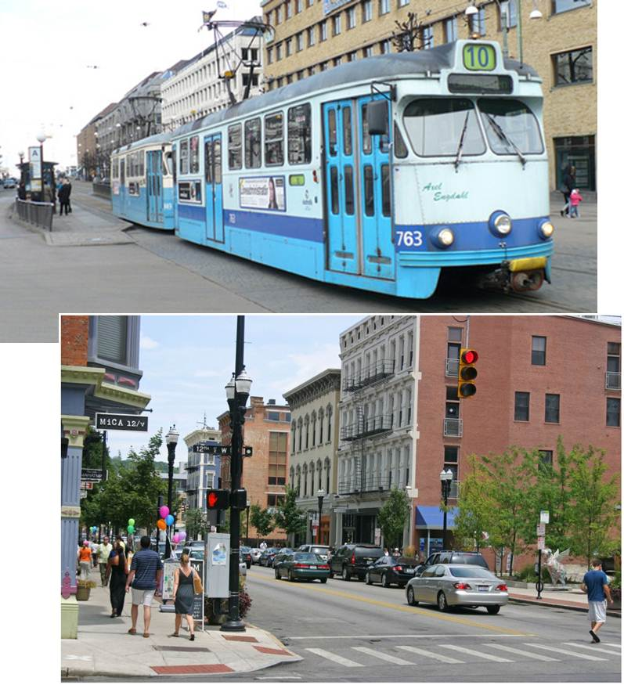
Compactness
slanich.zenfolio.com (Gothenburg, Sweden)
Walkable yet enough people to support transit
40 to 200 acres
Density supports
Density protects
Farr 2008
streetsblog.net (Cincinnati, Over-the-Rhine)
Notes:
Walkable yet enough people to support transit
40 to 200 acres
7 to 8 du/acre
Suburbia = ~2
Density supports
Transit service
Retail shops
District energy system
Density protects
undeveloped & sensitive lands
Density > 7 or 8 dwellings/acre
(Suburbia is ~2 dwellings/acre, not walkable)
Achievable w/ spectrum of housing types
Multifamily to large-lot detached single family
Reduced building envelope of multifamily dwellings saves 30-35 % HVAC
Center w/ apartments above stores
“Built in” customers
Walking replaces car trips
District energy systems
Less paved area / person
Save natural areas

Slide 5
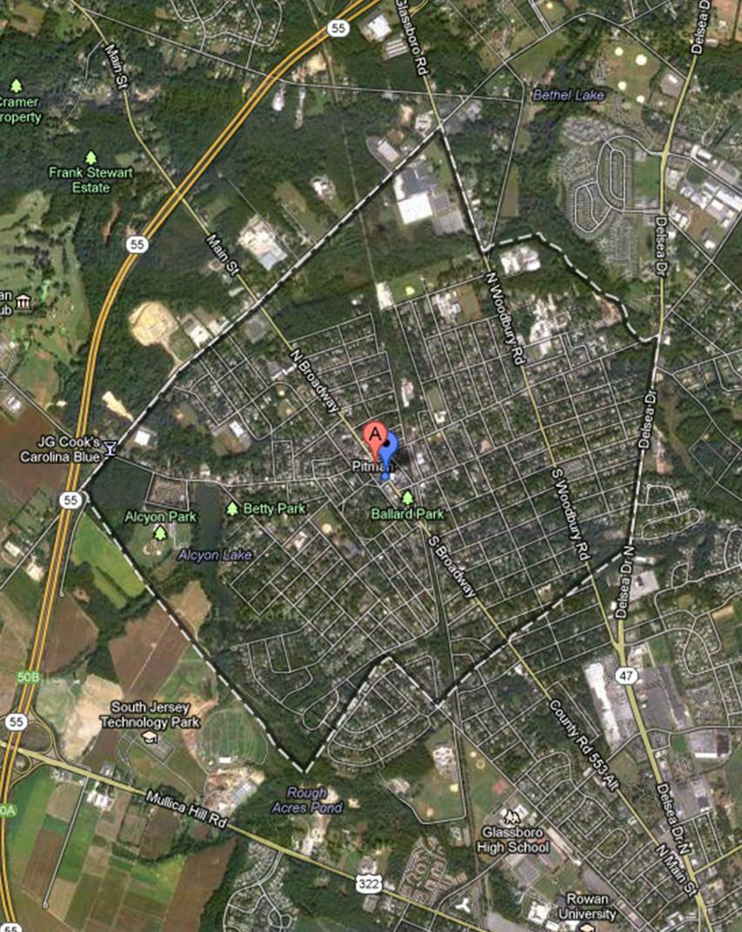
Pitman, NJ
3,571 Housing Units
1,471 Acres
Notes:
2.4 HU/acre
~3.5 omitting parks & woods
7 to 37 neighborhoods

Slide 6
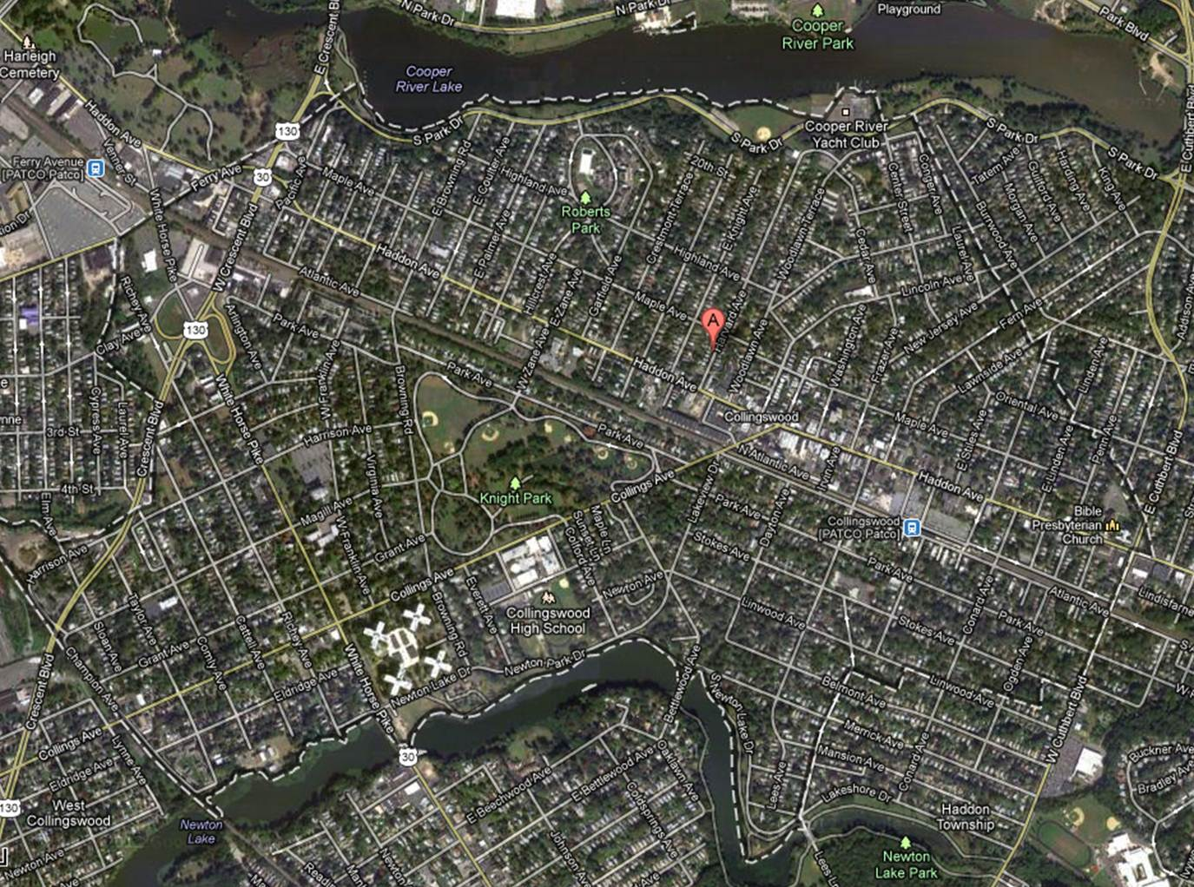
Collingswood, NJ
6,639 housing units in 1.923 mi² =
Notes:
6,639 housing units in 1.923 mi² = 5.5 du/acre

Slide 7
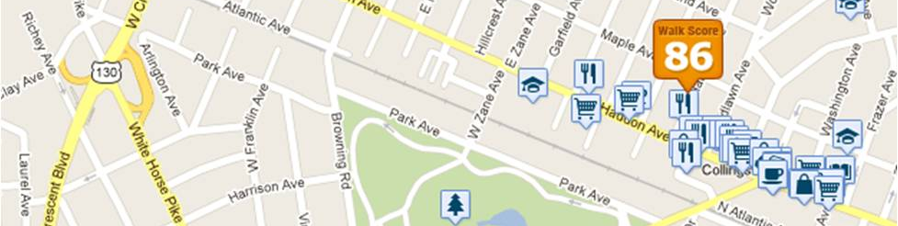
Completeness
Daily Needs
Lifetime Needs
Goal –
Collingswood NJ, very walkable, www.walkscore.com, 2013
Farr 2008
Notes:
Daily Needs
Corner Store, Day Care, Newstand, Coffe Shop, Deli, Food Market, Transit Stop, Offices, Workshops
Lifetime Needs
Starter Apartment, condominiums, starter home, larger home, assisted living facility, nursing home
Goal – Walk to your life from youth to old-age

Slide 8
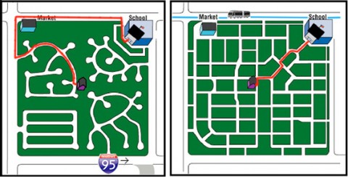
Connectedness - Internal
Walk, bike, wheelchair, drive opportunities
Streets
25-30 mph speed limits
Farr 2008
lawprofessors.typepad.com
Notes:
Walk, bike, wheelchair, drive opportunities
Streets
Grid (not Cul-de-sac)
Sidewalks both sides
Intersections <300-400’ apart
Narrow (2 lane)
25-30 mph speed limits
Safer and higher capacity

Slide 9
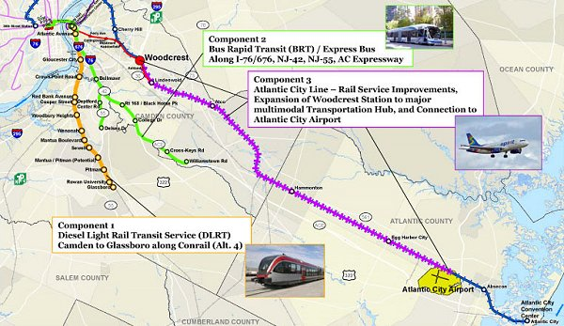
Connectedness - Corridors
Link neighborhoods with districts, etc.
Public Transit must be
Utility Integration w/ Public Transit
Farr 2008
blog.tstc.org, 2009
Notes:
Link neighborhoods with districts, etc.
Public Transit must be
Dependable to forgo autos
Built along previous lines or with “widely spaced stops at nodes of concentrated development”
Bus → ~7-8 du/acre
Trolley → ~15-20
Utility Integration w/ Public Transit
Electric, gas, sewer, district heating/cooling, graywater

Slide 10
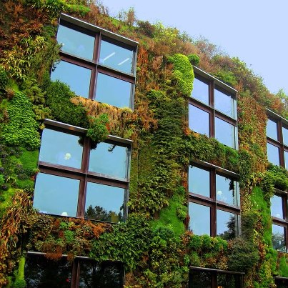
Biophilia
Connect w/nature
Make natural resource flows visible
Feedback on our effects
Support nonhuman species located near human communities
Farr 2008
sphotos-a.xx.fbcdn.net
Notes:
Connect w/nature
Health / brain benefit
Mature trees cool summer temp by 5 – 10 °F
People pay more for
lots near nature
Make natural resource flows visible
Feedback on our effects
Support nonhuman species located near human communities

Slide 11
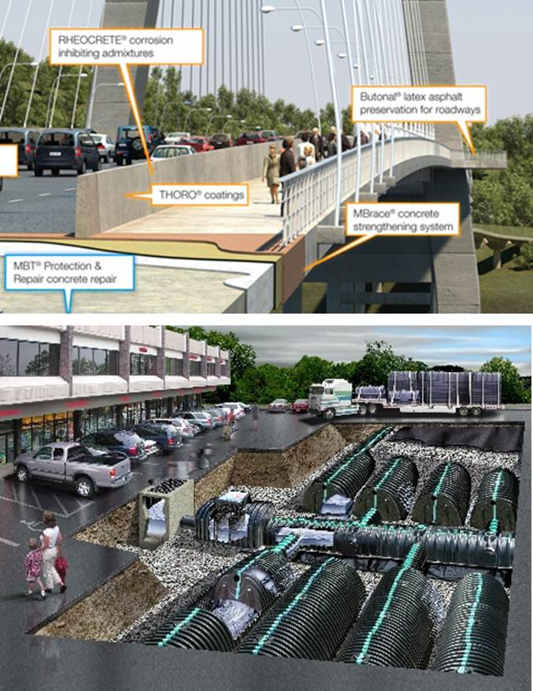
High Performance Infrastructure
www.ercshowcase.com
Goals
Reduce Overall Costs
Preserve Natural Spaces
High Density Neighborhoods
Shorter distances - utilities, roads, …
More efficient public transit
Examples
Reduce Urban Heat Island Effect
Stormwater Filtration
Recycled & Local Content
Long Lasting Road Surfaces
District Heating & Cooling
Farr 2008
www.internationalwastewater.com

Slide 12
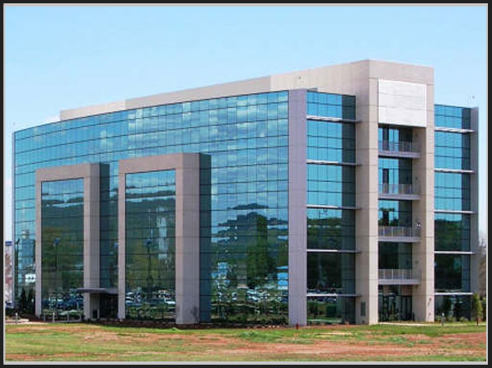
High Performance Buildings
LEEDS – 25 – 30 % more energy efficient
Reductions per capita, NOT per square foot
Multi-family dwellings inherently more efficient
Marshall Space Flight Center NASA
Solar power parking lot lights, Auto dimming / Light harvesting this building meets silver level requirements for Leeds building standards.
Farr 2008
www.jessestuttsinc.com

Slide 13
Integrated Design
Neighborhood as system
More efficient buildings, smaller utility system
More public transit, fewer parking spaces needed
Street grid means fewer miles driven
Building as system
Improve envelope and reduce HVAC needs
Farr 2008

Slide 14
Connectedness
High Performance Infrastructure
Biophilia
Notes:
Connectedness & Biophilia
Greenway w/Bike Path
Rail w/ Linear Park
Habitat Corridor
Infrastructure and Biophilia
Greenroof
Bioinfiltration Basin
Wastewater Wetlands
Connectedness & Infrastructure
Road w/ Integrated Utilities
Pervious Pavement

Slide 15
3 steps to Sustainable Urbanism
Weights and Measures (Standards)
Oil-Era Barriers
National Campaign
Farr 2008
Notes:
Weights and Measures
We must understand what Sus Urb is? Have easy ways to talk about it. And want it.
LEED for Buildings is a standard / brand already
LEED for Neighborhood development could be for Sus Urb?
Oil-Era Barriers (Auto dependence is hardwired)
Zoning
Roadway Standards
Parking Standards
Lack of standards (e.g., high-performance infrastructure)
National Campaign
Get people convinced they can have a “compelling quality of life with economic, health, and environmental benefits”
Leadership
Training
Model Projects

Slide 16
Weights and Measures
Pent up demand for Sustainable Urbanism can take off when recognizable standards are introduced
LEED for Neighborhood Development
Where – Location (infill or redevelopment)
What goes on – Mixed Use, Compact Development
How it is built and managed – High Performance
Farr 2008

Slide 17
Oil-Era barriers
Zoning & Land-use Regulations
Separate residential retail commercial zones
Minimum (large) school parcel size
Big box retailers
Roadway Design Standards
Encourage high speed long distance roads
Incomplete Environmental Regulations
Climate change and more
Farr 2008
Notes:
Lack of standards for high performance infrastructure

Slide 18
National Campaign
Better Technologies & Sustainable Urbanism
Technologies can be replaced over a decade
Changes in land use take longer to implement
Sell Sustainable Urbanism as an increase in quality of life, with benefits:
Economic
Health
Environmental
Leadership, Training & Model Projects
Farr 2008

Slide 19
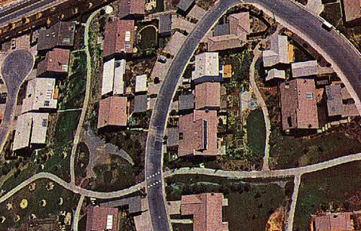
Davis, CA
Francis, M. (2002) Village Homes: A Case Study In Community Design, Landscape Journal 21:1-02
“Village Homes” 1974, 60 acres
Michael and Judy Corbett
220 single family homes, 20 apartments, cooperative house
Solar design features and solar hot water
Community Focus
Community center and common areas
Shared ownership of common areas
Community fruit and nut trees and vineyards,
Bicycling and walking orientation
www.ecocomposite.org
Notes:
Ecocomposite, http://www.ecocomposite.org/building/villagehomes.htm, accessed on 7/30/06
Sustainable Community - Village Homes, Davis, California By David A. Bainbridge (Former Planner in Davis, VH Resident, & VH Community Board Member) Associate Professor United States International College of Business Alliant International University San Diego, CA 92131 The primary focus of the development plan was on community building. Shared ownership of common areas and common spaces, shared laundry space for some units, shared gardens, community gardens, community fruit and nut trees and vineyards, and bicycling (much of the City of Davis commute is by bicycle) and walking orientation have been very successful in building community. In a study comparing Village Homes to surrounding contemporary development (standard suburbia) the residents of the Village Homes development knew 42 people in their neighborhood, compared to 17 in other areas. The average resident identifies 4 of their best friends in the community, compared to 0.4 for people in the conventional development. This community spirit and people orientation has also virtually eliminated crime (only 10% of the city average). Density is almost double surrounding areas, but the quality of life is much higher. This is reflected in increased home value (a $10-15 per square foot premium) and much quicker home sales in Village Homes.
Aerial View of Village Homes
Village Homes is an innovative mixed use planned unit development that was started in 1974 on 60 acres in Davis, California. It was designed and built by developers Michael and Judy Corbett, with help from many others. It was financed by Sacramento Savings and Loan and building was phased in over 5 years to allow for careful construction and sustained work for builders. At build-out it includes 220 single family homes, 20 apartments and a cooperative house, most incorporating solar design features and solar hot water. Business space is included in the community center and an inn was recently completed. There is a comprehensive community center, with pool, meeting and party rooms, and large playing field. The developer allowed individual builders to buy lots, although 60% of the homes were built by the Village Homes company. This added diversity in design and an opportunity for innovation. Several builders who got their start in Village Homes were able to build their own homes in the development and have become major local builders in the community. The developer also built a home and he and his family have always lived in the community.
The orientation of streets and paths was also designed to facilitate natural heating and cooling using winter sun for solar heating and shade and night-time ventilation cooling for relief from the summer heat. This followed suggestions made by the consulting firm Living Systems in reports to the City of Davis on the performance of conventional apartments and homes and an innovative climate adapted building code and workbook (since supplanted by the much less sophisticated and cumbersome Title 24 state standards). The original program worked very well and included training for builders and building officials. Homes are known for improved comfort and bills average about 50-60% of surrounding developments. The comfort is also aided by narrow streets which reduce the urban heat island effect. Energy conservation, comfort and safety are also aided by bicycle and pedestrian orientation and narrow streets. The fight for narrow streets was difficult, and succeeded only after Living Systems developed guidelines for street design for the City of Davis based on European research showing that narrower streets were safer. Off street parking, a focus of houses toward the bikeways not the street, and limited through traffic enabled street width to be cut from 44-52 feet in conventional developments to 20-26 feet in Village Homes. This also reduces cost, minimizes overheating during the hot summer, reduces stormwater drainage problems, and improves the quality of life by minimizing traffic and noise. The second biggest struggle was over above-ground storm water drainage in natural looking swales with infiltration basins. This was considered heretical by the City engineers, but after a long fight it was approved. It was tested by very heavy rains not long after it was completed and Village Homes was one of the only areas in the City that didn't flood. Subsequent developments have added even larger retention basins and infiltration ponds. On many evenings muskrats, ducks, geese and other birds can be seen enjoying these park features, and they conserve water and return it to the groundwater resource for use. Village Homes demonstrated to all involved that development can work for people and the environment. It is a lasting tribute to the energy, wisdom and persistence of the Corbetts. It set a standard for new villages to match or equal. As the Corbetts say, "We do not view Village Homes as an ideal. We see it as a step in the right direction." We know much more know and can and should do much better today.

Slide 20
Davis, CA Study
Francis, M. (2002) Village Homes: A Case Study In Community Design, Landscape Journal 21:1-02
Village Home resident
knows 42 people in neighborhood (17 in control)
identifies 4 of best friends in Village Homes (0.4 in control)
Virtually no crime
Density almost 2x surrounding areas
Quality of life much higher
Increased home value & quicker home sales

Slide 21
Sustainable Urbanism Pillars
Defined Center & Edge
Compactness
Completeness
Connectedness
Biophilia
High Performance Buildings & Infrastructure
Population
Technology
Life Style
Environment

